Slide 1


H ₂
Patent Analysis and Solution for Hydrogen Cell Vehicles with Fire Proofing Technology
Dequn Teng, Miaomiao Zou, Chen Ye, Can Cui
10th Feb 2022

Slide 2
01 Patent Background
02 Search Strategy 03 Existing Technologies 04 Our choice 05 Reflection & Challenges
Content

Slide 3
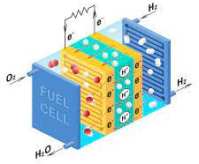
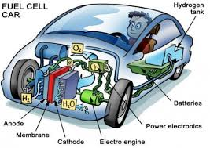
Hydrogen Fuel Cells (HFC)
▪ Reduced greenhouse gas emissions ▪ High Reliability ▪ Flexibility in installation and operation ▪ Development of renewable energy resources
▪ Reduced demand for foreign oil
▪ Improved environmental quality
Hydrogen fuel cell vehicles
2H₂ (g) + O₂ (g)
2H₂ O +Energy
https://www.google.com/

Slide 4
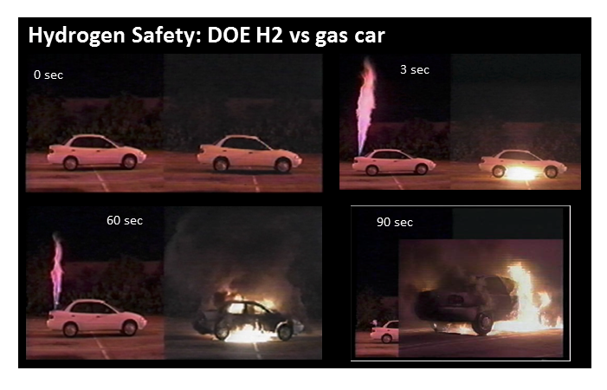
Fire-proofing for HFC
Solution for Hydrogen Cell Vehicles with Fire Proofing Technology
Hydrogen is an inflammable gas but can explode under certain circumstances of confinement or oxygen concentration.
https://hydrogen.wsu.edu/2017/03/17/so-just-how-dangerous-is-hydrogen-fuel/

Slide 5
Database
Search String
Keywords and synonym
Constructed Formula
Filter
Search Strategy
Result
Time based analysis
Patentee
Highly selected patent
Feedback
Search Strategy
Part 2

Slide 6
Search Strategy
Search String
Keyword Decompose
Synonym
OR Synonym AND parts
Search String Update
Database
Lens
Patentee
Highly cited patent
Results and Visualization
Timeseries analysis
Patentee
Highly cited patent

Slide 7
Search String_01 Keywords and synonym
6
Fuel
Cell
Hydrogen
Energy
Powered
Fire
Battery
Electronic cell
Hydrogen oxygen
H
HO
H-O
Hydrogen gas
proton exchange membrane
H2
H oxygen
Flame
Explosion gas
Blaze heat
Smoke
Sparks
Burst
Blast
Inflammable
Confinement
Oxygen concentration
Burnable
Combustion
Vehicle
Automobile
Boat
Car
Van
Truck
Plane
System
Based system
System based
Storage tanks
Generator
Prevention
Proof*
Protection
Retardant
Extinguishing
Retarding
Resistance
Stop
Arrester
Keywords

Slide 8
Search String_02 Constructed Formula
title:(Hydrogen OR (Hydrogen oxygen) OR H OR HO OR H-O OR (hydrogen gas) OR (proton exchange membrane) OR H2 OR (H oxygen)) AND (Fuel) AND (Cell OR battery OR (electronic cell)) AND (Vehicle OR Automobile OR Boat OR Car OR Van OR Truck OR Plane OR (storage tanks) OR generator OR system) AND (fire OR flame OR explosion OR gas OR blaze OR heat OR smoke OR Sparks OR burst OR blast OR inflammable OR confinement OR oxygen concentration OR burnable OR combustion) AND (prevention OR proof* OR protection OR retardant OR extinguishing OR Retarding OR Resistance OR stop OR arrester)
&& abstract: (Hydrogen OR (Hydrogen oxygen) OR H OR HO OR H-O OR (hydrogen gas) OR (proton exchange membrane) OR H2 OR (H oxygen)) AND (Fuel OR energy OR powered) AND (Cell OR battery OR (electronic cell)) AND (Vehicle OR Automobile OR Boat OR Car OR Van OR Truck OR Plane OR (storage tanks) OR generator OR system) AND (fire OR flame OR explosion OR gas OR blaze OR heat OR smoke OR Sparks OR burst OR blast OR inflammable OR confinement OR oxygen concentration OR burnable OR combustion) AND (prevention OR proof* OR protection OR retardant OR extinguishing OR Retarding OR Resistance OR stop OR arrester)
Keywords
AND
Synoyms
OR
Filter
Title
Abstract

Slide 9

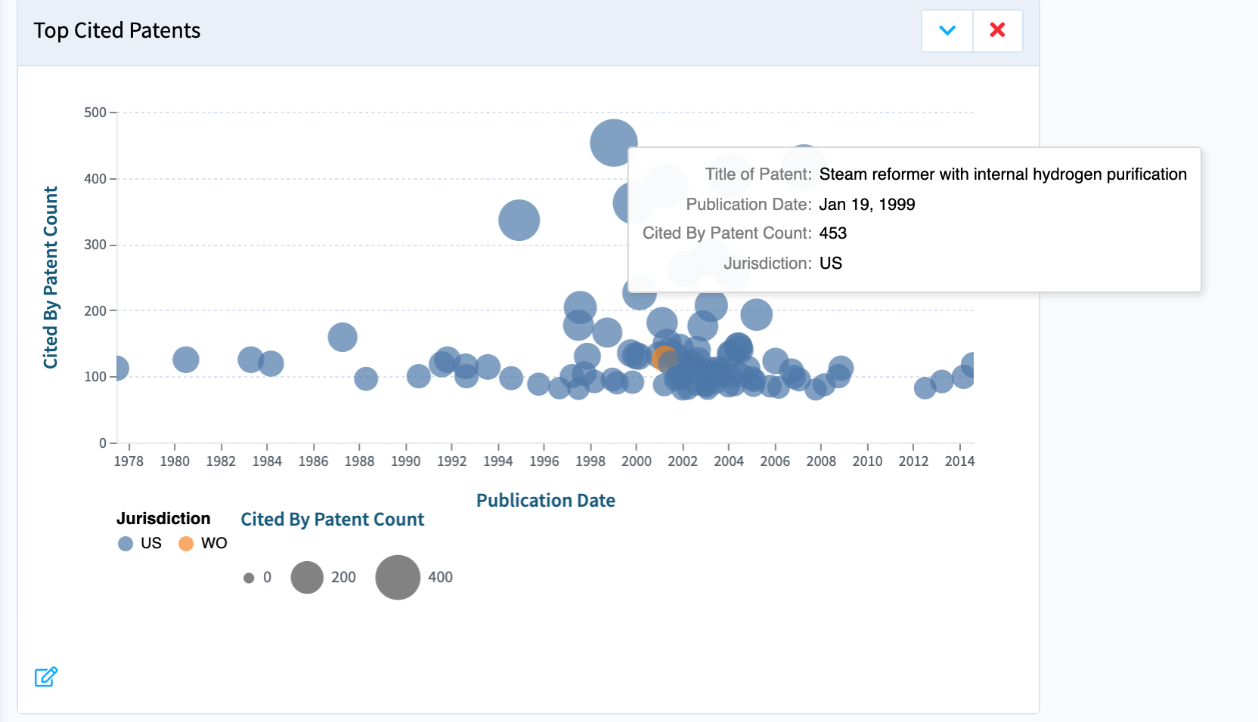
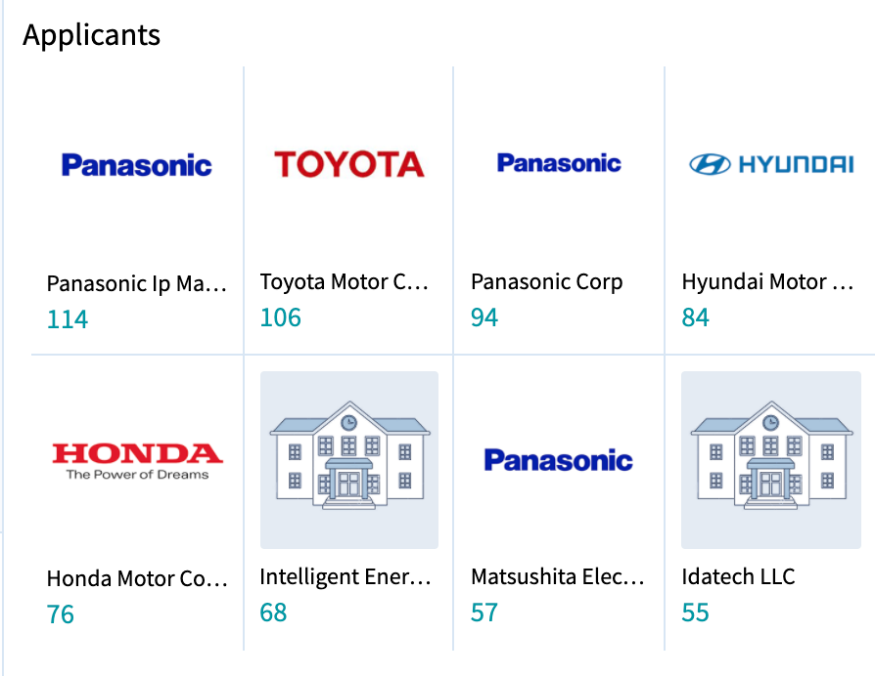
Database
Lens
https://www.lens.org/
Reasons
User Interface
Jurisdiction filter
Legal status filter
Easy script
Visualization
Patent owner
Highly cited patents
Free

Slide 10
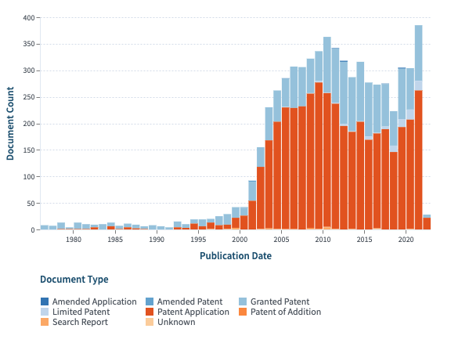
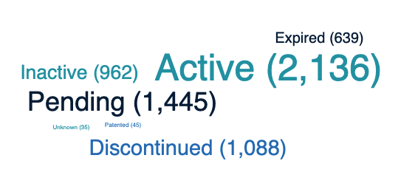
Technology development and patent analysis
Patent documents over time
Patent documents by Legal Status

Slide 11
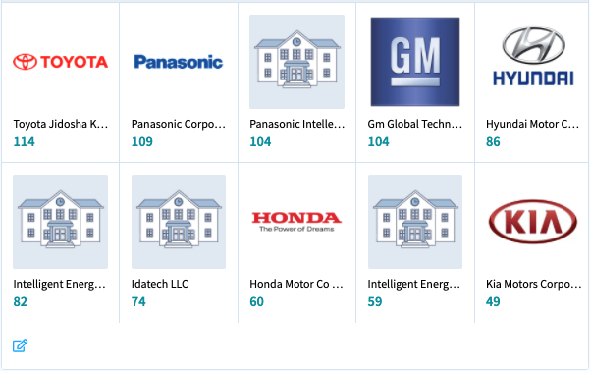
Top Owners

Slide 12
Patent documents by Jurisdiction

Slide 13
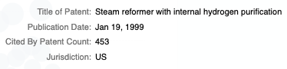
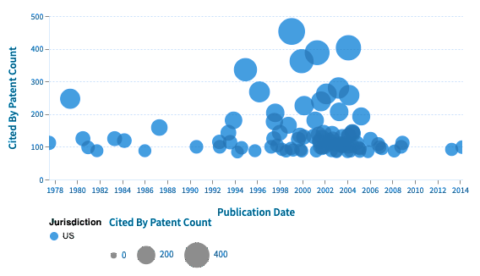
Highly selected patent

Slide 14
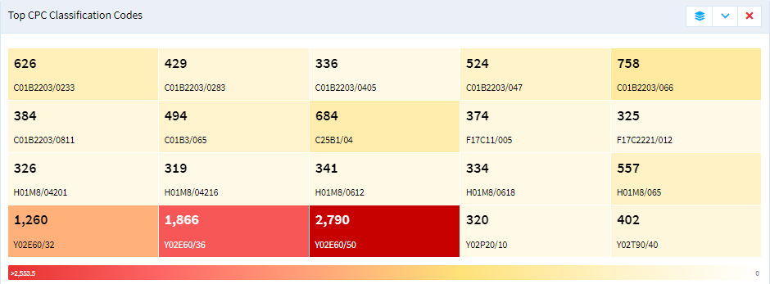
Technology Class
Dominant technology (3-digit patent classification) :
Technologies or applications for mitigation or adaptation against climate change (Y02)
Dominant technology (4-digit patent classification) :
reduction of greenhouse gas emissions, related to energy generation, transmission or distribution (Y02E)

Slide 15
Technology Class
Other technology classes (3-digit CPC classification) :
Basic electric elements (H01)
Inorganic chemistry (C02)
Other technology classes (4-digit CPC classification) :
Processes or means, e.g. batteries, for the direct conversion of chemical energy into electrical energy (H01M);
Non-metallic elements; Compounds thereof (C01B)

Slide 16
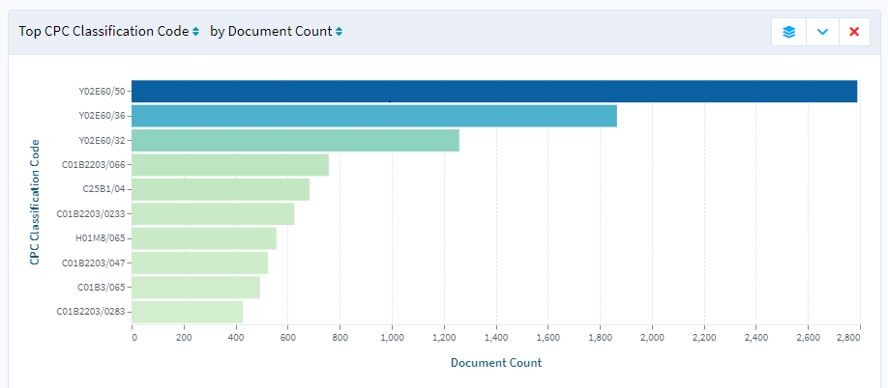
Technology Class
Other technology classes (4-digit CPC classification) :
Electrolytic or electrophoretic processes for the production of compounds or non-metals; apparatus therefor (C25B)
Reduction of greenhouse gas emissions, related to energy generation, transmission or distribution (Y02E)
Processes or means, e.g. batteries, for the direct conversion of chemical energy into electrical energy (H01M);
Non-metallic elements; Compounds thereof (C01B)

Slide 17
Inactive patents
Active patents
Existing Technologies
Part 3

Slide 18
Patents Analysis for Inactive and Active Patents
Preparation
Highly relevant
Patent 1 Patent 2 Patent 3 Patent 4 Patent 5 Patent 6 Patent 7 Patent 8
Search String
Patent Analysis
Generalization
Solution
Highly cited
Patent 9 Patent 10 Patent 11 Patent 12 Patent 13 Patent 14 Patent 15 Patent 16

Slide 19
Inactive patents
Hydrogen and oxygen battery, or hudrogen and oxygen to fire a combustion engine and/or for commerce.
Hydrogen and Oxygen Gases, Produced on Demand by Electrolysis, as a Partial Hybrid Fuel Source for Internal Combustion Engines
Hydrogen/oxygen fuel cell
On Demand Hydrogen Enhancement System for Internal and External Combustion Engine
Hydrogen/oxygen Fuel Cell
Hydrogen/oxygen generating system with temperature control
Portable Compact Electrolytic Hydrogen-Oxygen Gas Generating and Conditioning Apparatus
Hydrogen/oxygen Generating System With Temperature Control
Steam reformer with internal hydrogen purification
Method for the production of hydrogen-containing gaseous mixtures
Hydrogen producing fuel processing system
Steam reformer with internal hydrogen purification
Hydrogen generation by hydrolysis of hydrides for undersea vehicle fuel cell energy systems
System for hydrogen generation
Method and system for supplying hydrogen for use in fuel cells
Method of producing membrane electrode assemblies for use in proton exchange membrane and direct methanol fuel cells

Slide 20
Active patents
System and method for generating hydrogen and oxygen gases
Electrolyzed hydrogen gas enhancement of hydrocarbon fuel combustion
Hydrogen production system and methods of using same
System for generating and supplying hydrogen gas to an internal combustion engine
Hydrogen and oxygen generator
Hydrogen On-Demand Fuel System for Internal Combustion Engines
Hydrogen Gas Dispensing Systems and Methods
Hydrogen-Oxygen Gas Generator and Hydrogen-Oxygen Gas Generating Method Using the Generator
Mobile hydrogen generation and supply system
Compact solid source of hydrogen gas
Bio-electrochemically assisted microbial reactor that generates hydrogen gas and methods of generating hydrogen gas
Electrochemical Apparatus to Generate Hydrogen and Sequester Carbon Dioxide
Hydrogen storage in nanostructures with physisorption
Apparatus to reduce the cost of renewable hydrogen fuel generation by electrolysis using combined solar and grid power
Electrolysis Of Carbon Dioxide In Aqueous Media To Carbon Monoxide And Hydrogen For Production Of Methanol
Hydrogen Filling Apparatus And Hydrogen Filling Method

Slide 21
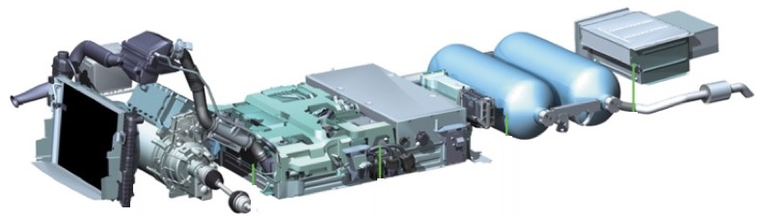
Existing technologies from inactive patents
I
II
III
IV
V
VI
VII
Cooling System
Electric
Motor
Power
Electronics
Fuel
Cell
Hydrogen
Tanks
High Voltage
Battery
Hydrogen Generation
2003
14
Metal hydride solution & catalyst system
1992
3
5
Air adjustment valve
Pressurized reactor
1
Re-enforced thermolysis reactor and turbine housing
1992
2002
15
2001
2007
2
Relay link apparatus
& Fuse link apparatus
1993
13
Cylindrically-walled portion
2002
6
Generate gas readily on demand
2011
7
Gas outlet
https://h2tools.org/sites/default/files/Safety_Considerations_for_Hydrogen_and_Fuel_Cell_Applications.pdf

Slide 22
Existing technologies from active patents
I
II
III
IV
V
VI
VII
Cooling System
Electric
Motor
Power
Electronics
Fuel
Cell
Hydrogen
Tanks
High Voltage
Battery
Hydrogen Generation
14
3
5
15
1
这页需要学长和璀璨补充一下
2
13
6
7

Slide 23
Technology acquisition
Market layout
Our choice
Part 4

Slide 24


Technology Acquisition
Inactive
Patent
Directly borrowed for use
Active
Patent
Cross-licensing

Slide 25
Cooperative owners for cross-linking
I
II
III
IV
V
VI
VII
Cooling System
Electric
Motor
Power
Electronics
Fuel
Cell
Hydrogen
Tanks
High Voltage
Battery
Hydrogen Generation
14
3
5
15
Hunt Robert Daniel
1
此页需要学长和璀璨把好专利的拥有者弄上去
即，交换许可的对象。
我弄了个“15”的示范
2
13
6
7

Slide 26
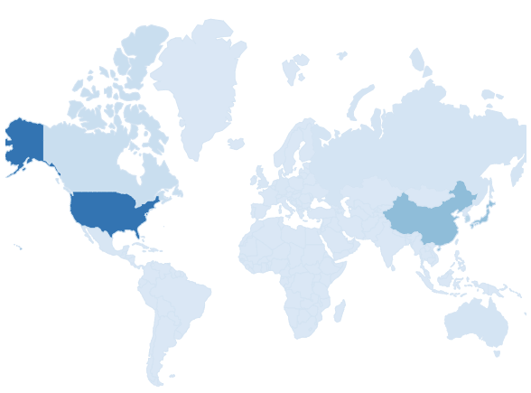
Market layout

Slide 27




Feedback
“
“
“
“
If non-interested patents?
——Filter on Title and Abstract and Identify the “escaped synonym”
Find the reason for the dubious patents and polish search term.
More is not better
The diversity of key words is not proportional to the accuracy;
High cited does not mean high relevant.
High relevancy and high citation may be helpful, but this is not the only criterion.
”
”
”
”

Slide 28
H ₂
Thank you!
Q & A
Patent Analysis and Solution for Hydrogen Cell Vehicles with Fire Proofing Technology
Dequn Teng, Miaomiao Zou, Chen Ye, Can Cui
10th Feb 2022

Slide 29
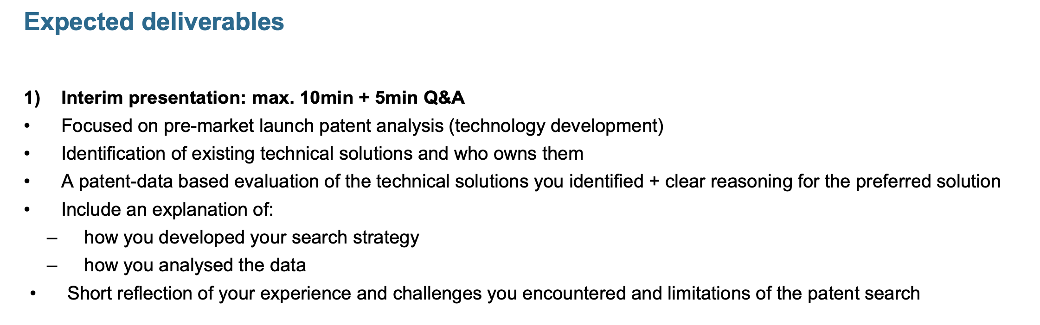

Slide 30
